Slide 1

Spaceship Titanic
T:
TEAM:
Kobe Martinez Gregory Celestino
Daniel Rodas Angel Serrano Santiago Bautista

Slide 2
Topic: who was left
With the Titanic being one of the most iconic tragedies, we were motivated to go back to the future and learn more of how many were lost.
Our main goal is to try to predict who got transported and who were not after the crash of the space titanic.
We also wanted to see which algorithm gave our the best accuracy percentage. With better accuracy score, the more accurate the results are.

Slide 3
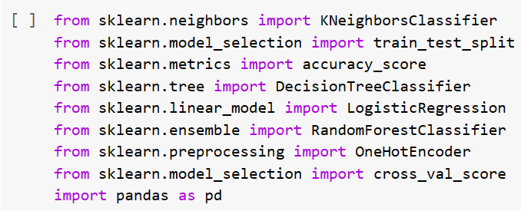
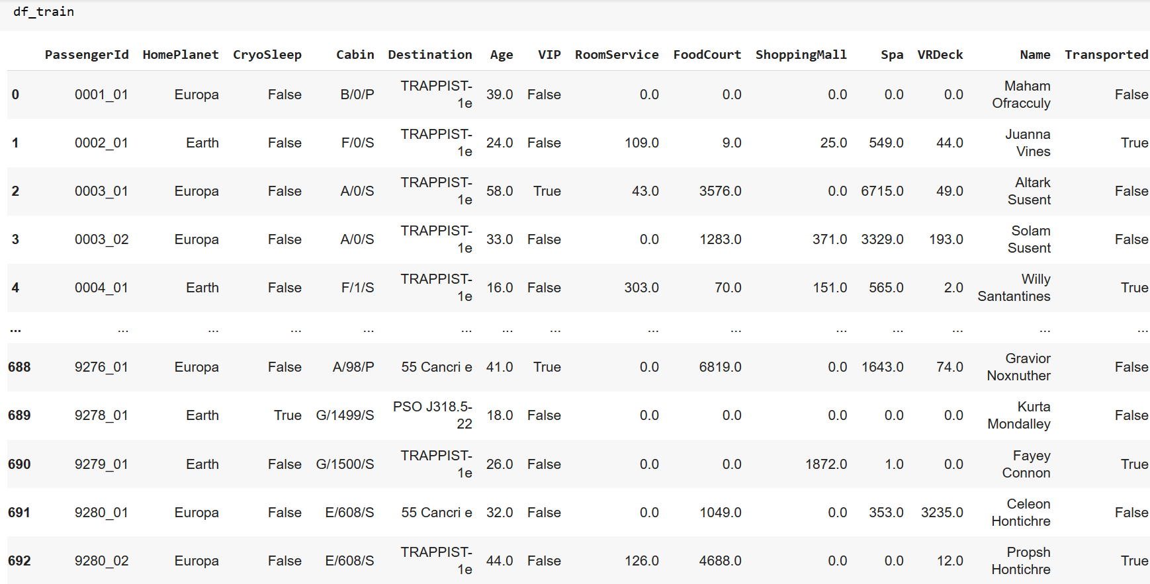
CSV File
We first decided to go with the training data frame instead of the testing data frame because the training data frame had much more data and a y target which all in all is much more reliable than the unsupervised data frame that is the testing data frame.
We then converted the training data frame into a csv file for future exploration with our machine learning algorithms.
CSV file
KNN
We decided to have selected features that seem to be the most important in our perspective.
Decision Tree
Logistic Regression
Random Forest
Linear Regression

Slide 4
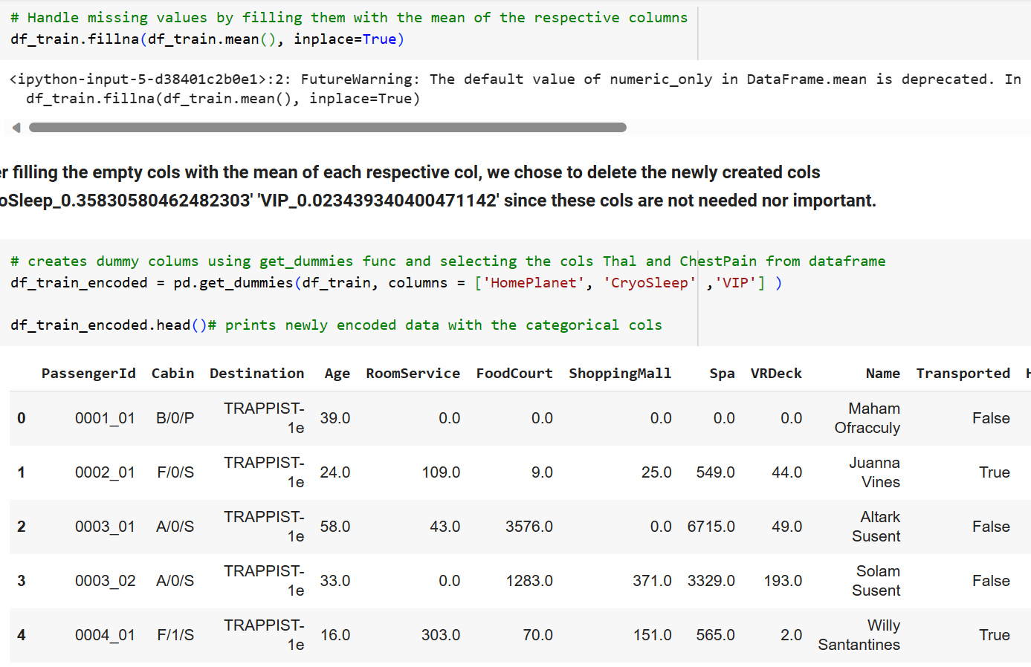
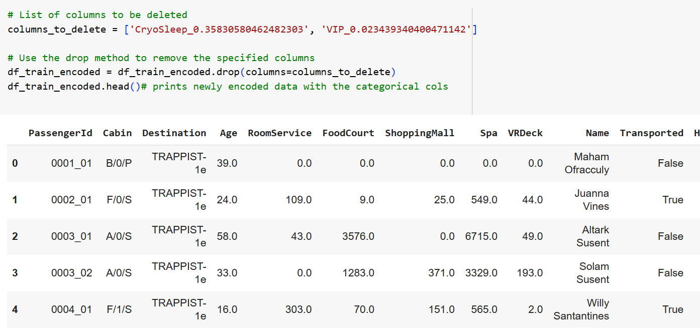
CSV File
Noticed that there was various empty cols within the data frame that were labeled as ‘NaN’. This created an issue without code since the algorithms could not read empty cols, therefore we figured a way to fill in the empty cols with the mean of the respective surrounding cols using the function ‘fillna’.
We created dummy columns for the selected features since the algorithms aren’t capable for reading categorical data.
We then deleted the unnecessary Cryosleep and VIP columns that were created when making the dummy features.
CSV file
KNN
Decision Tree
Logistic Regression
Random Forest
Linear Regression

Slide 5
CSV File
CSV file
In total our list of features consist of :
'Age','HomePlanet_Earth','HomePlanet_Europa','HomePlanet_Mars','CryoSleep_False','CryoSleep_True','VIP_False','VIP_True'
We then moved all the features into feature_cols which we then inputted into the newly made dataframe df_train_encoded to X. With the y label , we simply set it as the y since ‘Transported’ is our target label
As the default train split for our first machine learning algorithm we made the testing data cover 20 percent of the data while the rest of the 80 percent is for training data. Lastly, we set random state to 9 since it was our best value through our testing.
KNN
Decision Tree
Logistic Regression
Random Forest
Linear Regression

Slide 6
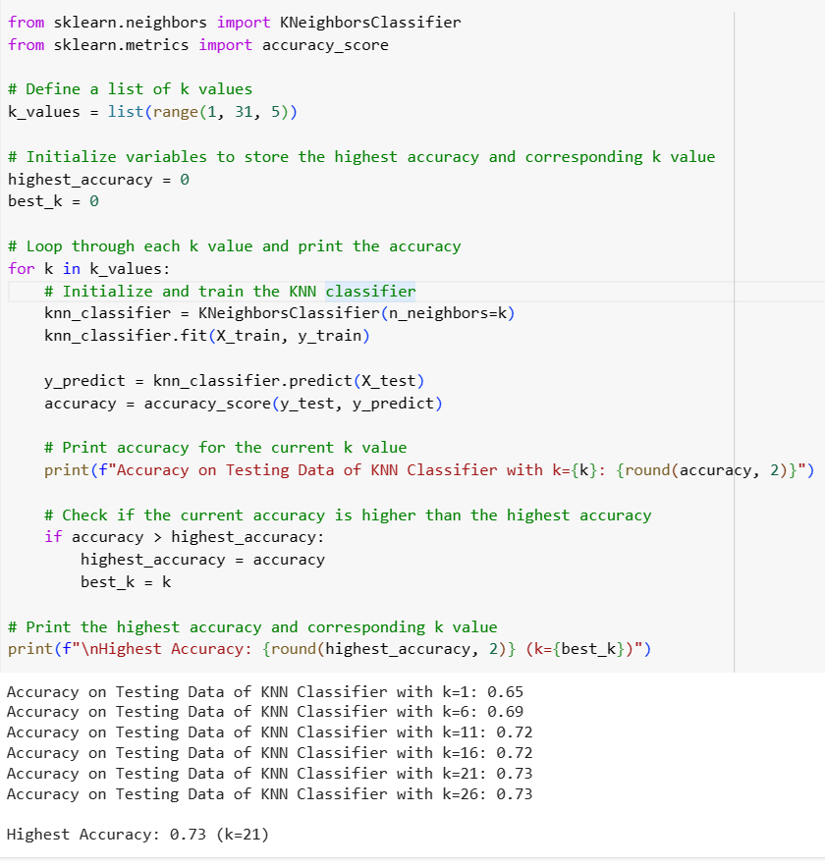
KNN Classifier
k-Nearest Neighbor (KNN) is a machine learning algorithm used for both classification and regression tasks which relies on the input data itself during training so meaning it does not build a model.
With using this algorithm with Spaceship Titanic, create a list of k values from 1 to 31 with a step size of 5. These values will be used to test the KNN classifier with different number of neighbors. Loop checks for current highest accuracy seen so far.
Output shows accuracy for each k value tested and identifies the k value that resulted in the highest accuracy in the test data, in this case, k = 21 and highest accuracy being 0.73.
CSV file
KNN
Decision Tree
Logistic Regression
Random Forest
Linear Regression

Slide 7
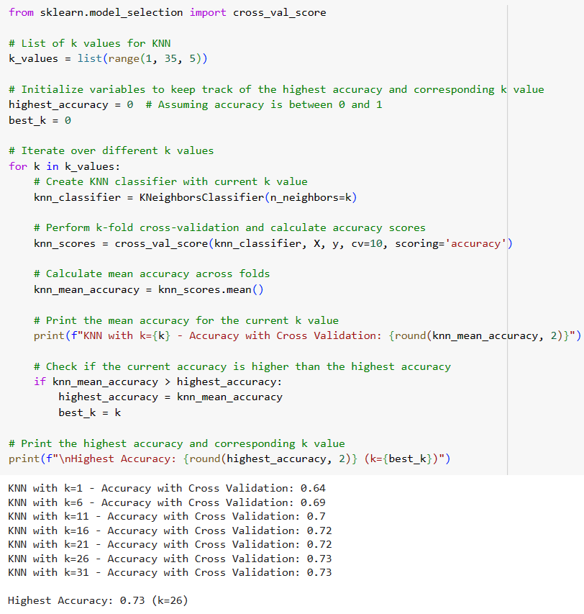
KNN with Cross-Validation
Cross Validation is a technique used to evaluate the performance of a model on unseen data. With Cross-Validation, we simply called in the import and the cross_val_score function to get and calculate the accuracy score.
After we use mean function for the scores we simply retrieve the output and got the highest percentage which was 73 percent with the k value being 26.
We made sure to expand the amount of variables to see if and when the output changes.
CSV file
KNN
Decision Tree
Logistic Regression
Random Forest
Linear Regression

Slide 8
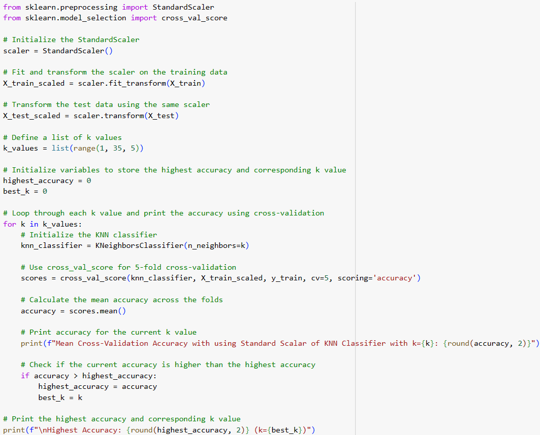
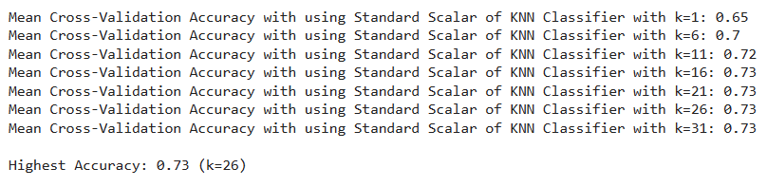
KNN using Standard Scalar and Cross Validation
CSV file
KNN
Standard Scalar is preprocessing step used to standardize the features of the dataset before applying the KNN algorithm.
Comparable and preventing certain features from having a disproportionate impact on the KNN algorithm due to differences in their scales.
Decision Tree
Logistic Regression
Random Forest
Linear Regression

Slide 9
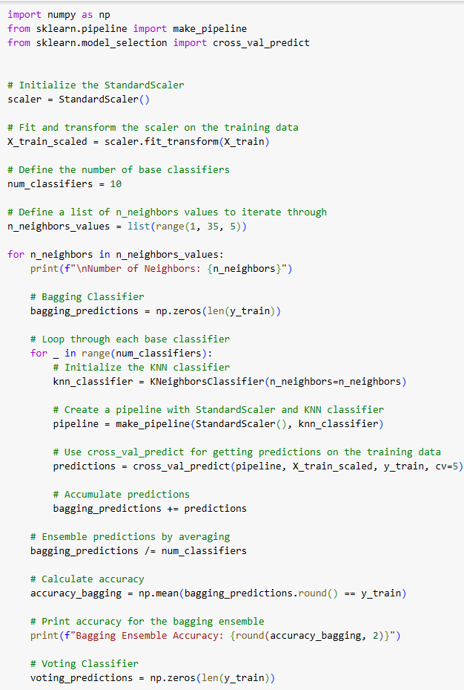
KNN with Cross-Validation, Standard Scalar using Bagging and Voting
Code uses nested loops to iterate over different values of ‘n_neighbors’.
Number of base classifiers is set to 10, and a list of ‘n_neighbors values defined from 1 to 35 by 5’s.
Bagging Classifier: It initializes multiple KNN classifiers, each trained on a subset of the data, and combines their predictions by averaging.
Voting Classifier: It initializes multiple KNN classifiers and combines their predictions by majority voting.
CSV file
KNN
Decision Tree
Logistic Regression
Random Forest
Linear Regression

Slide 10
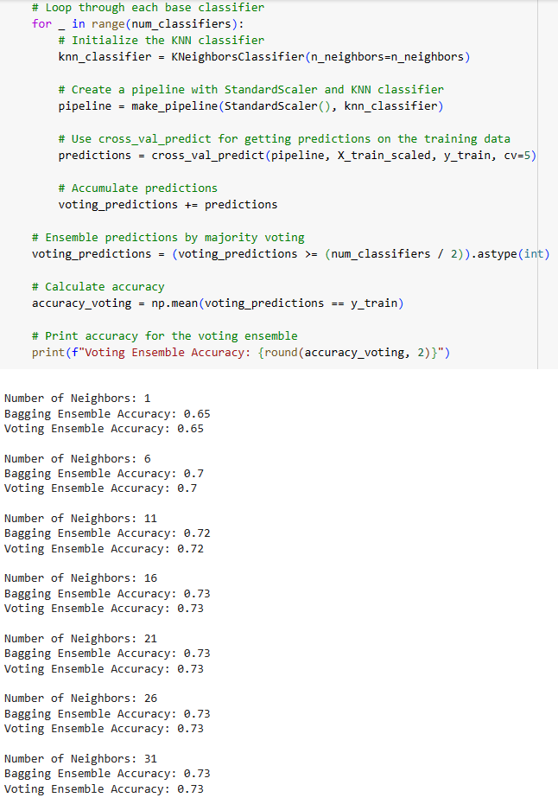
KNN with Cross-Validation, Standard Scalar using Bagging and Voting
The output suggests that, for the given dataset, the choice of ‘n_neighbors’ does not significantly impact the accuracy of the Bagging and Voting ensembles.
The accuracy remains relatively stable across different values of ‘n_neightbors’.
Both Bagging and Voting ensembles consistently achieve accuracies around 0.73 for the specified number of base classifiers, in this case ‘num_classifiers = 10’.
CSV file
KNN
Decision Tree
Logistic Regression
Random Forest
Linear Regression

Slide 11
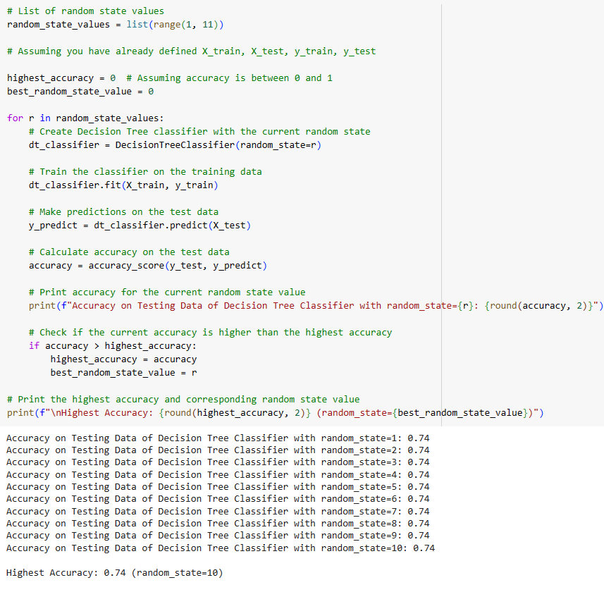
Decision Tree Classifier
Decision Tree is a flowchart-like structure in which each internal node represents a “test” on an attribute, where each branch would represent the outcome of the test, with each leaf node that represents a class label.
Applying this to our project to find who was transported on the Spaceship Titanic, thus splitting our data for training and testing it through our algorithm would give us the accuracy of the Decision Tree through iterating from the random values. We find through with the highest accuracy of 0.74 or 74%.
CSV file
KNN
Decision Tree
Logistic Regression
Random Forest
Linear Regression

Slide 12
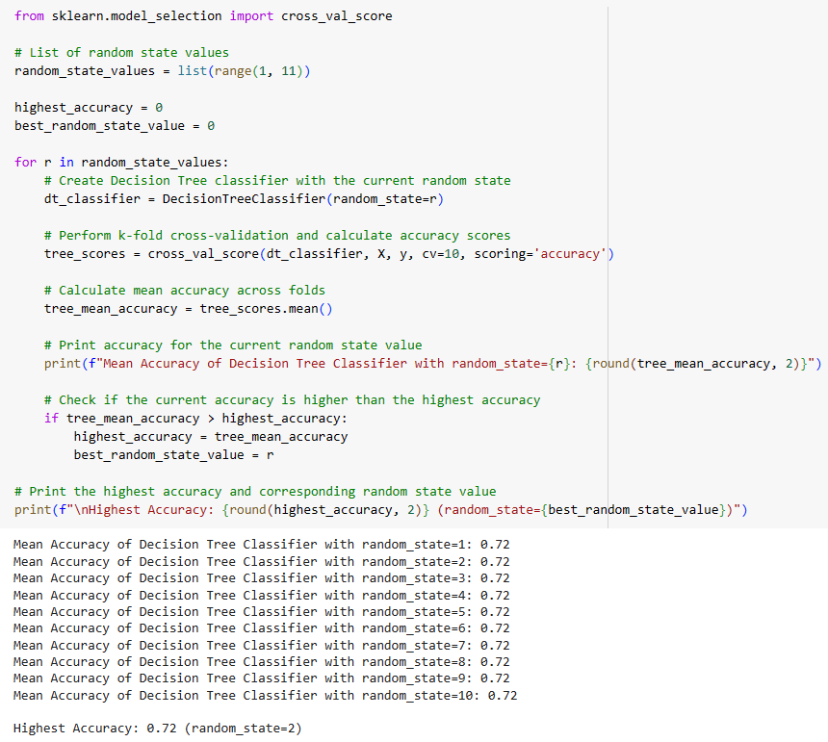
Decision Tree with Cross-Validation
We next apply the Cross-Validation to the Decision Tree algorithm which will aid us to give an efficient evaluation by splitting the data into multiple subset to train and test in order to validate the model several times.
Though the percent was reduce by 2% this results to making the Decision Tree with Cross-Validation for a more realistic estimate of the accuracy of our data which gives us the accuracy of 0.72 or 72%.
CSV file
KNN
Decision Tree
Logistic Regression
Random Forest
Linear Regression

Slide 13
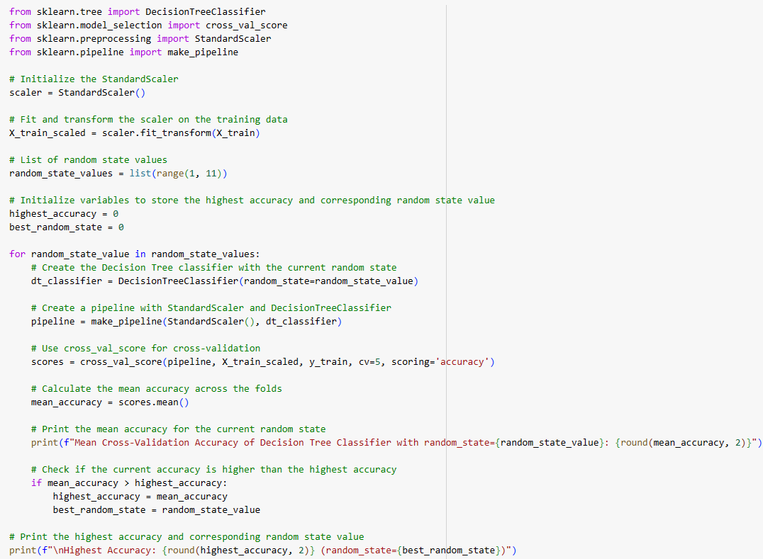
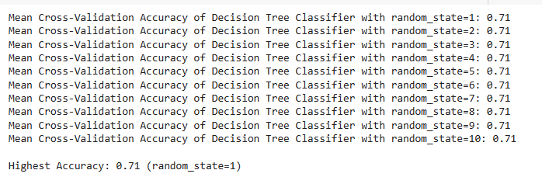
Decision Tree using Standard Scalar and Cross-Validation
Applying the Standard Scalar to Decision Tree and Cross-Validation would give us another possibility of a more realistic accuracy. By adding Standard Scalar this will allow us to transform the training data in such a way that it has a mean of 0 and standard deviation of 1.
In addition, the Standard Scalar makes a slight difference compare to without having it in the algorithms with the finalization for the accuracy to be 0.71 or 71%.
CSV file
KNN
Decision Tree
Logistic Regression
Random Forest
Linear Regression

Slide 14
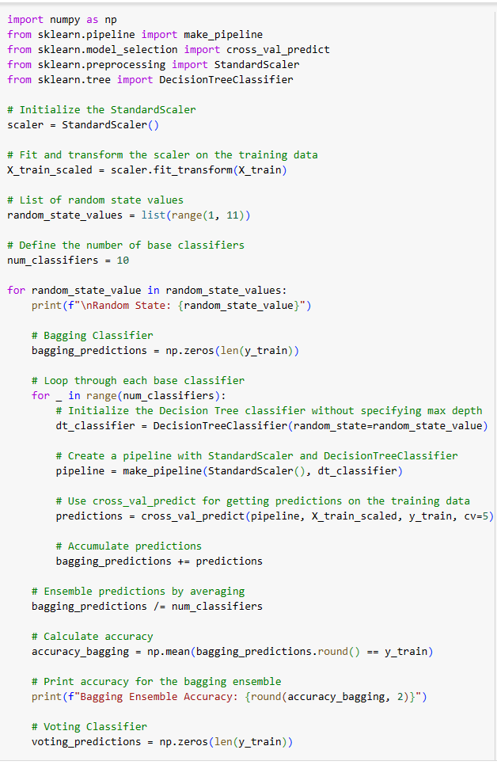
Decision Tree with Cross-Validation and Standard Scalar using Bagging and Voting
Applying Bagging and Voting would allow us to get an efficient and accurate output of our display as we will be including Bagging and Voting after the Standard Scalar and Cross-Validation to train multiple instances of random values from the base model with different subsets of training data then ensembles with Bagging and Voting in the technique so that we could combine the prediction with all the models.
CSV file
KNN
Decision Tree
Logistic Regression
Random Forest
Linear Regression

Slide 15
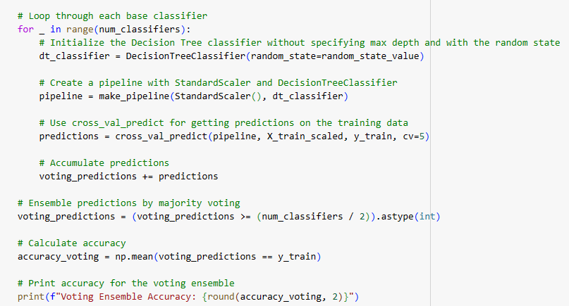
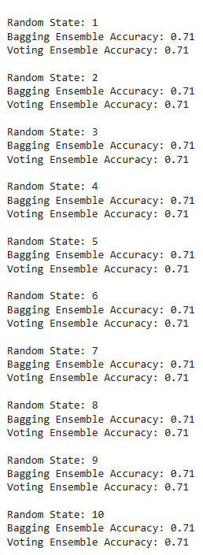
Decision Tree with Cross-Validation and Standard Scalar using Bagging and Voting
Thus finally looping through each base classifier for both Bagging and Voting Ensemble to predict the finalization of the accuracy thus resulting of having both Bagging and Voting Ensemble Accuracy to be 0.71 or 71%.
When it came to the output we made sure to print out the different random states which each of their own Bagging and Voting Ensembling.
CSV file
KNN
Decision Tree
Logistic Regression
Random Forest
Linear Regression

Slide 16
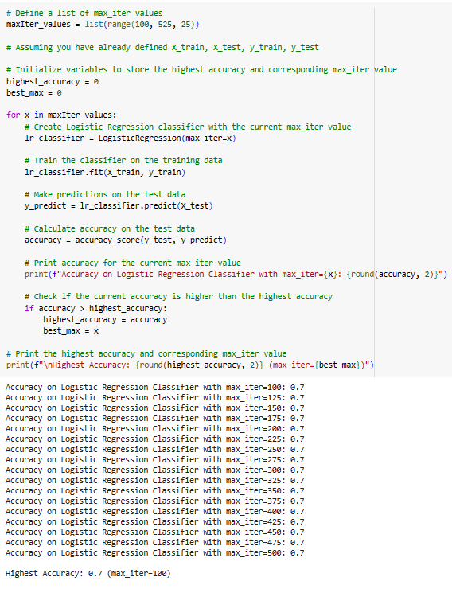
Logistic Regression
Logistic Regression is a binary classification to give a out of 2 possible outcome yes or no. Applying this to our project to find who was transported on the space titanic, splitting our data and testing it through our algorithm on the accuracy of logistic regression through iterating through the values. We find through basic Logistic Regression we get a max accuracy of 0.7 or 70%
CSV file
KNN
Decision Tree
Logistic Regression
Random Forest
Linear Regression

Slide 17
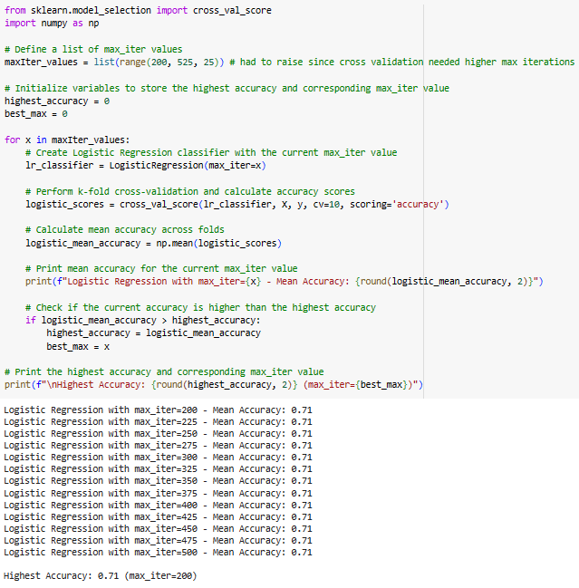
Logistic Regression with Cross-Validation
Applying Cross Validation to the Logistic Regression algorithm will help give us more robust evaluation by splitting the data into multiple subsets to train and validate the model multiple times. The Logistic Regression with Cross-Validation formula gives us a slightly better accuracy at 0.71 or 71%.
One of the key notices was that 71 percent was the result for all possible max-iterations.
CSV file
KNN
Decision Tree
Logistic Regression
Random Forest
Linear Regression

Slide 18
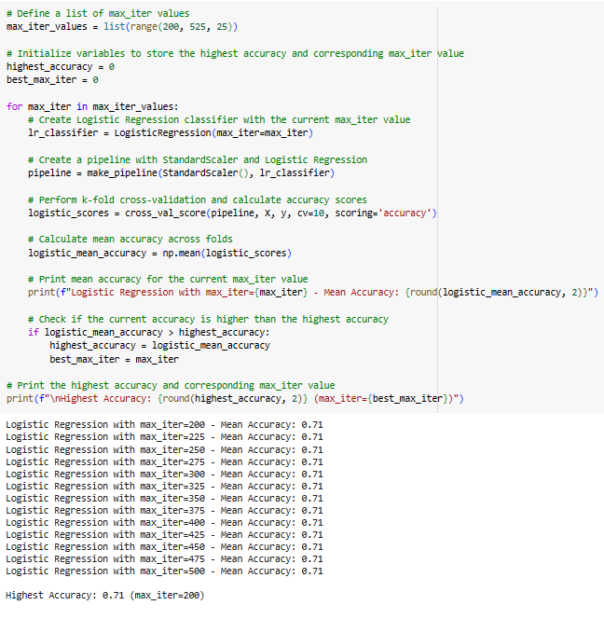
Logistic Regression Classifier using Standard Scalar and Cross-Validation
Applying Standard Scalar to Logistic Regression and Cross-Validation gives another possibility to give a better accuracy. Applying Standard Scalar before Cross-Validation allows us to transform the data in such a way that it has a mean of 0 and a standard deviation of 1. The addition of Standard Scalar does not change the accuracy of the algorithms output staying at an accuracy of 71%
CSV file
KNN
Decision Tree
Logistic Regression
Random Forest
Linear Regression

Slide 19
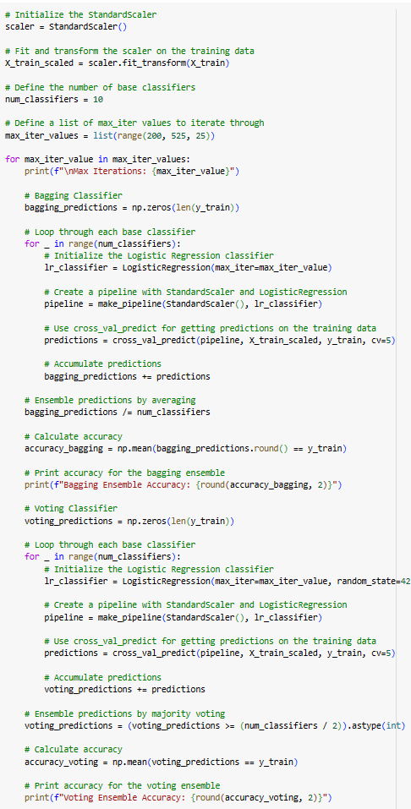
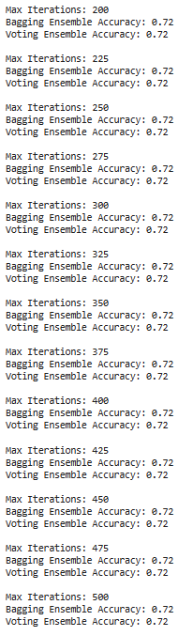
Logistic Regression with Cross-Validation and Standard Scalar using Bagging and Voting
Applying Bagging and Voting once again allows us to get a more robust and accurate accuracy output.
We apply Bagging and Voting after Standard Scalar and Cross-Validation which Trains multiple instances of the same base model on different subsets of training data then comes this is Bagging and Voting is an ensemble of techniques that combines the prediction of many models to make final prediction. This new algorithm gives a slightly higher accuracy at 0.72 or 72%.
One of the key notices was that the accuracy percentage of 72 was the result for all possible max iterations for this machine learning algorithm.
CSV file
KNN
Decision Tree
Logistic Regression
Random Forest
Linear Regression

Slide 20
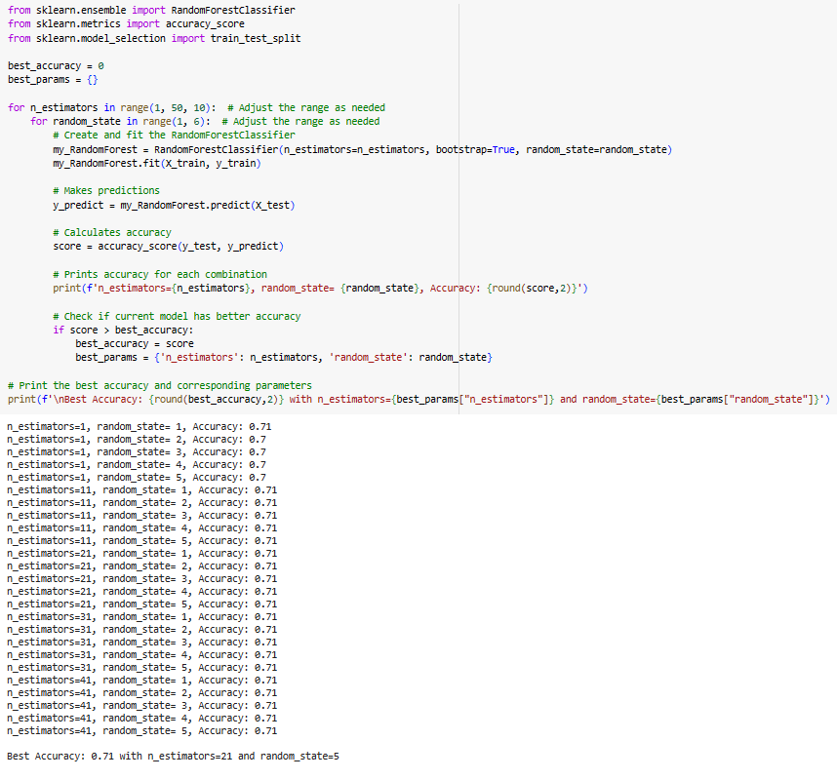
Random Forest Classifier
Random Forest as a learning method operates by constructing several decision trees at the training stage, and then combining the prediction results.
CSV file
KNN
Decision Tree
Logistic Regression
Random Forest
Random Forest as a learning method operates by constructing several decision trees at the training stage, and then combining the prediction results.
For our testing purposes, we used the data and ended up with a general 71% accuracy with occasional dips to 70%
Linear Regression

Slide 21
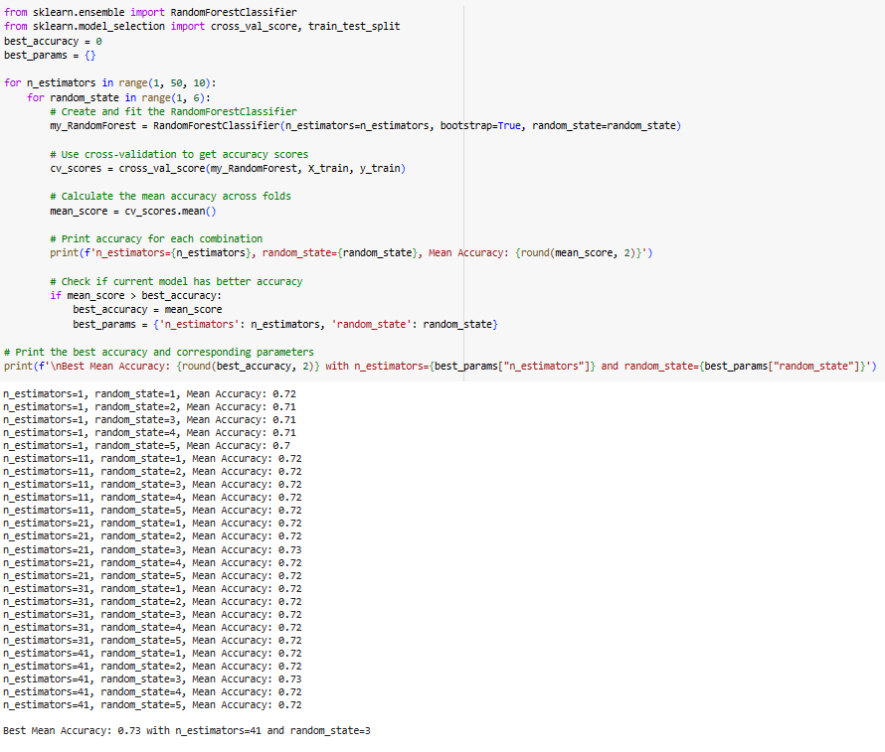
Random Forest with Cross-Validation
CSV file
KNN
Decision Tree
Logistic Regression
When testing Random Forest with Cross-Validation, our mean accuracy score ranged from 71% to 73%. The best mean score occurring when the random state was 3.
Random Forest
Linear Regression

Slide 22
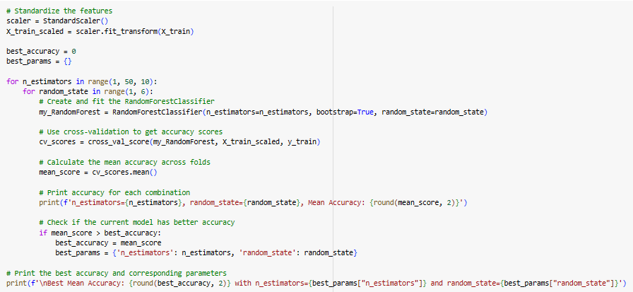
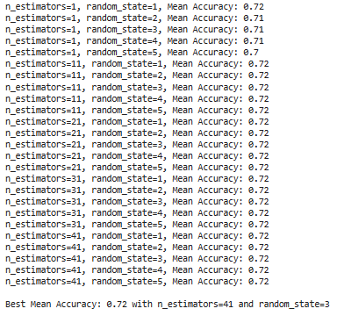
Random Forest using Standard Scalar and Cross-Validation
CSV file
KNN
Decision Tree
Logistic Regression
After applying standard scalar to our test results, we add another data point to make our overall results more accurate, in this we got a fluctuating range of 70 to 72%.
One of the key notices is that that any n_estimator higher than 11, gave out the output of 72 percent accuracy.
Random Forest
Linear Regression

Slide 23
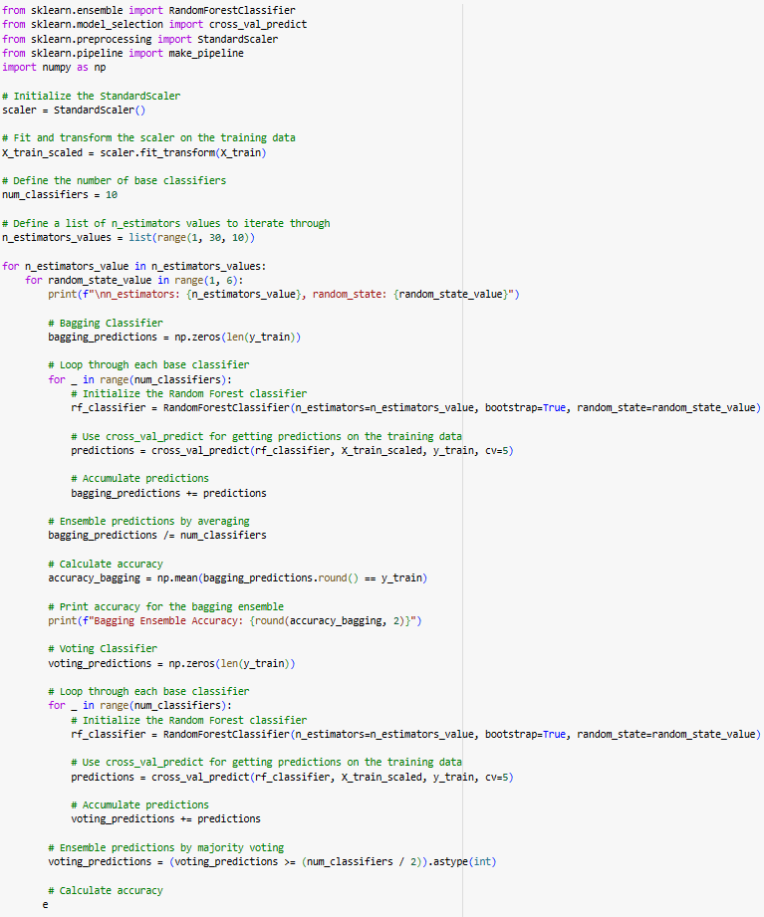
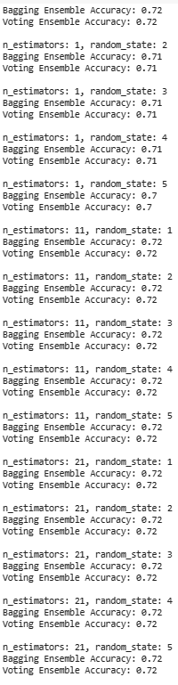
Random Forest with Cross Validation, Standard Scalar using Bagging and Voting
After standard scalar and cross validation trains multiple instances of the same base model, we apply bag and voting to make our results more robust and accurate.
In this case, we were left with an accuracy score that ranged from 70% to 72%.
CSV file
KNN
Decision Tree
Logistic Regression
Random Forest
Linear Regression

Slide 24
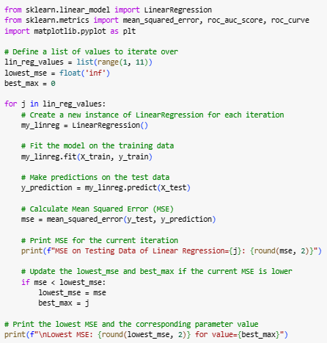
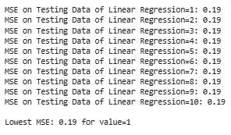
Linear Regression
Linear Regression is a statistical method used to model the relationship between a dependent variable and one or more independent variable by fitting them in a linear equation to the data.
Applying this to our Space Titanic situation we train the data in the new instance of Linear Regression Iterations we set up we try to find the Mean Squared Error or MSE we get an output of 0.19 and in the situation of MSE within Linear Regression the closer the MSE is to 0 the more accurate it is.
CSV file
KNN
Decision Tree
Logistic Regression
Random Forest
Linear Regression

Slide 25
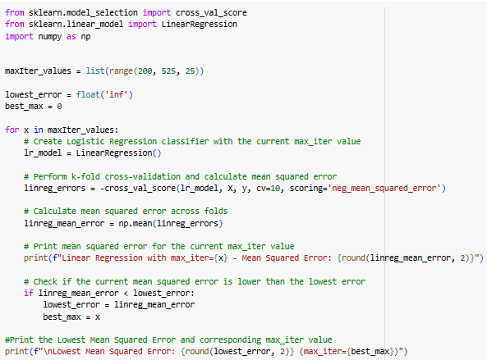
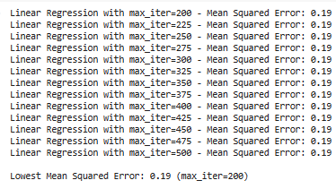
Linear Regression with Cross-Validation
Applying Cross Validation to Linear regression gives a more robust estimate of the model's performance by splitting the dataset into multiple subsets, training the model on some of these subsets, and evaluating it on the remaining subsets.
The New algorithm will iterate through more subsets but will still give an output of 0.19 which is not an improvement without Cross-Validation.
CSV file
KNN
Decision Tree
Logistic Regression
Random Forest
Linear Regression

Slide 26
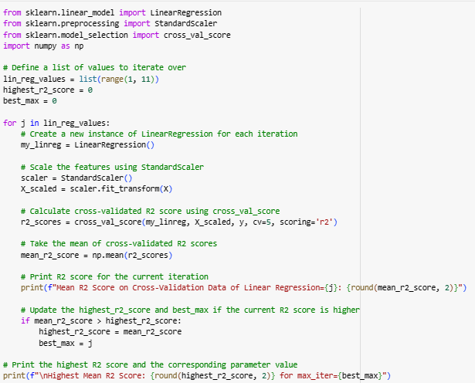
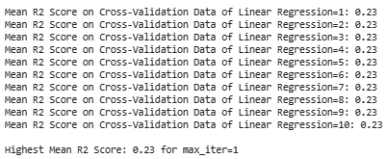
Linear Regression with Standard Scalar and Cross Validation
When Applying Standard Scalar we have to apply it before Cross Validation allowing Standard scaling involves transforming the features (independent variables) to have a mean of 0 and a standard deviation of 1.
This is done to address issues related to the scale of the variables. This new Algorithm we are searching for the Highest Mean R2 score which gives us an output of 0.23 which in the means of MSE is about -19 which is the same as to the previous algorithms
CSV file
KNN
Decision Tree
Logistic Regression
Random Forest
Linear Regression

Slide 27
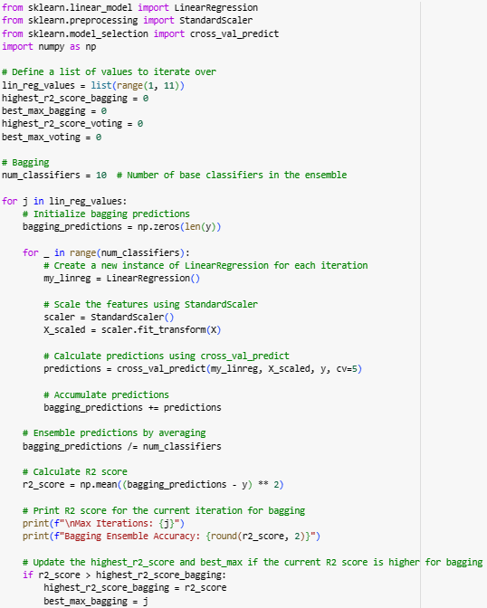
Linear Regression with Cross Validation and Standard Scalar using Bagging and Voting
CSV file
When applying bagging and voting to Linear Regression with Standard Scalar and Cross-Validation we apply it at the end of the Cross-Validation which trains multiple instances of the same base model on different subsets of training data then comes this is Bagging and Voting is an ensemble of techniques that combines the prediction of many models to make final prediction.
KNN
Decision Tree
Logistic Regression
Random Forest
Linear Regression

Slide 28
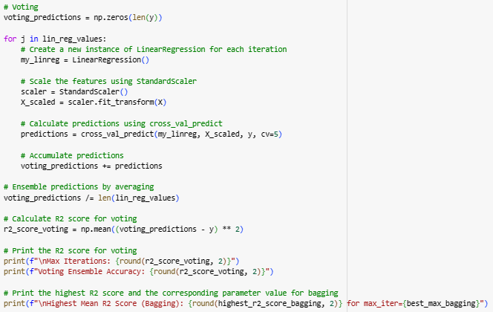
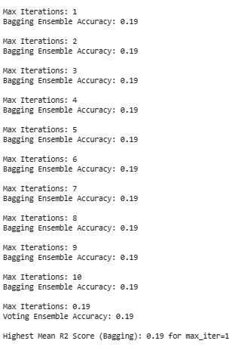
Linear Regression with Cross Validation and Standard Scalar using Bagging and Voting
CSV file
KNN
Decision Tree
Logistic Regression
With the bagging and voting done calculating r2 score which previously we got a 23 we find the result to be 19 which in the context of R2 score the higher the number the better so we find that this algorithm is worse.
One of the key notices was that 19 was a constant result for all possible Max-iterations.
Random Forest
Linear Regression

Slide 29
The best and the worst
The best algorithm we have tested and used was Decision Tree Classifier Method. The Decision Tree Classifier accuracy score was 74 percent alone. With using other algorithms such as cross validation , standard scalar.
The worst classifier was Logistic Regression Classifier with the accuracy of only 70 percent which doesn't seem that kind of a big difference but because we are dealing with the lives of many people, 4 percent makes a big difference. Unlike with Decision Tree Classifier, when we ran it with cross-validation and standard scalar, the Logistic Regression Classifier went up by 1 or 2% when running it with cross-validation and standard scalar.

Slide 30
THANK YOU
Questions?

